Slide 1
Background & Objectives
• Implemented Carver's systematic trading strategy across a diversified futures portfolio.
• Estimated volatility and correlation for risk management.
• Performance evaluated via Sharpe and drawdown
Notes:
Background & Objectives
Implemented systematic trading strategies based on Robert Carver’s methodology.
Assets: diversified futures portfolio across equities, bonds, and commodities.
Back-adjusted continuous futures data using Panama method to remove roll gaps and correctly account for dividends and interest (avoids treating them as losses).
Volatility and correlation estimates used for risk management; annualization valid assuming low autocorrelation in returns.
Evaluation metrics:
- Sharpe Ratio (excess return over risk-free rate / volatility) — penalizes volatility regardless of upside or downside.
- Sortino Ratio (excess return over risk-free rate / downside volatility) — focuses on negative skew and fat tails.
- Both ratios complement each other; higher Sharpe allows safer leverage for higher returns.
- Drawdown analysis: Average Drawdown preferred over Max Drawdown for fat-tailed return distributions.
- Tail risk measured via lower/upper percentile ratios instead of kurtosis.

Slide 2
Strategy 1: Buy & Hold (Baseline)
• Naive fixed long-only strategy per asset serves as baseline benchmark.
• Expected high volatility, low Sharpe ratio and large drawdowns highlight need for risk-adjusted strategies.
Notes:
Strategy 1: Buy & Hold (Baseline)
Naive fixed-position long-only strategy per asset.
Serves as benchmark for performance comparison.
Expected: high volatility, low Sharpe ratio, large drawdowns.
Drawdown and fat-tail behavior highlight the importance of risk-adjusted strategies.

Slide 3
Strategy 2: Constant Volatility Target
• Daily position sizing to maintain fixed annualized volatility (e.g. 20%).
• EWMA volatility (λ≈0.6) smooths vol estimates and avoids fake spikes.
• Volatility clusters short-term but mean reverts longer-term, improving stability across regimes.
Notes:
Strategy 2: Constant Volatility Target
Daily position sizing to maintain fixed annualized target volatility (e.g., 20%).
EWMA volatility estimation (λ ≈ 0.6 optimal per Carver p.99) avoids fake volatility jumps caused by old large returns dropping out of the window.
Volatility clusters in the short run but mean reverts long term.
Improves stability of risk profile across regimes.

Slide 4
Strategy 3: Variable Volatility Target
• Adaptive target volatility blending short & long-term estimates.
• Increase risk in calm periods; reduce risk during turbulence to avoid overreaction.
• Weight long-term covariance heavily to prevent oversized positions during crises.
Notes:
Strategy 3: Variable Volatility Target
Adaptive target volatility blending short-term and long-term vol estimates.
More risk in calm periods, less in turbulent ones — mitigates overreaction to transient spikes.
Prevents oversized positions during crises by weighting long-term covariance more heavily (≥ 20 days for stability).

Slide 5
Strategy 4: Portfolio Risk Parity
• Scale each asset by volatility; adjust for correlations for equal risk contribution.
• Use long-term covariance for stable correlation estimates.
• Portfolio leverage derived from total risk appetite over single-contract risk
Notes:
Strategy 4: Portfolio Risk Parity
Volatility-scale each asset, then adjust for correlations to achieve equal risk contribution.
Long-term covariance preferred for stable correlation estimates.
Portfolio-level leverage calculated via:
Leverage Ratio = Total Risk Appetite / Risk of Single Contract.
Contracts with higher initial margins require more capital to start and to cover potential losses.

Slide 6
Strategy 5: Trend-Following Overlay
• Use trend filter (e.g. MACD) to modulate positions; exit longs rather than shorting.
• Size positions by volatility; cap extreme indicator values and preserve relative strengths.
• Equities/commodities bounce after strong negative trends; VIX drops sharply after positive trends.
Notes:
Strategy 5: Trend-Following Overlay
Apply trend filter (e.g., MACD) to modulate positions:
- Do not short — use trend signals to close long positions instead.
- More effective for long positions; reduces whipsaw losses.
Adjust position size by volatility, not by raw confidence score.
Capping extreme indicator values avoids blow-ups but min–max scaling can preserve relative strength unless extremes are nonsensical.
Equity/commodities tend to bounce sharply after strong negative trends; opposite not true.
VIX tends to drop sharply after strong positive trends; opposite not true.

Slide 7
Strategy 6/7: Trend Strength Sizing
• Position size proportional to trend strength with caps for risk control.
• Handle extreme values via capping or scaling; include reversal probabilities for robustness.
• Trend strength sizing can raise CAGR while keeping drawdowns contained if long term alpha present.
Notes:
Strategy 6/7: Trend Strength Sizing
Position size proportional to trend signal strength, capped for risk control.
Extreme values handled with capping or scaling to avoid overexposure and quick reversals.
Potential to increase CAGR while keeping drawdowns contained.
Reversal probabilities can be incorporated into sizing logic for further robustness.

Slide 8
Key Learnings
• Risk management & sizing matters more than raw signal accuracy.
• Blending volatility horizons smooths adjustments; high Sharpe strategies can be levered.
• Diversification & trend overlays improve skew and robustness; size signals with caps & aim for ~½ Kelly; delay trading until look-back periods fill.
Notes:
Key Learnings
Risk management & position sizing drive performance more than raw signal accuracy.
Volatility estimation: Blending horizons smooths position adjustments.
Sharpe > Returns — higher Sharpe strategies can be safely levered.
Diversification + trend overlays improve skew and robustness.
Signal strength sizing adds incremental gains but must have strict caps.
Kelly optimal risk ≈ Sharpe Ratio, but practical target should be ~½ Kelly.
Maintain initial weights or delay trading until look-back periods are populated to avoid early over-sizing.

Slide 9
Final Results
• After applying all strategies (0.05% cost): Total return 5.65, CAGR 41.29%, Vol 31.94%, Sharpe 1.24.
• Max drawdown –33.27%; total trades 810 over 2020-2025.
• After applying all strategies (0.05% cost): Total return 8.45, CAGR 11.6%, Vol 14.5%, Sharpe 0.83.
• Max drawdown –32.5%; total trades 1483 over 2005-2025.
Notes:
Final Results
Results after applying all strategies with transaction cost of 0.05% per trade:
- Total Return: 1.6597
- CAGR: 19.54%
- Volatility: 19.37%
- Sharpe Ratio: 1.0191
- Max Drawdown: -24.27%
- Total Trades: 559

Slide 10
Performance by Regime (2005–2025)
• Outperformance occurs in post-shock volatility normalization vs quiet trends; rolling Sharpe peaks after 2008–09, 2011 and post-COVID. Maybe because we leverage more after losses
• Vol targeting with EWMA stabilizes risk; trend overlay avoids whipsaws; blended covariance reduces swings and drawdowns.
• Best suited for periods of volatility normalization and trend resumption.
Notes:
Performance by Regime (2005–2025)
Observation: Strategy outperforms in post-shock normalization phases (elevated but decaying volatility) versus long quiet trends.
Evidence (3-year rolling Sharpe): Peaks cluster after 2008–09, 2011, and post-COVID, not during extended low-volatility drifts.
Mechanism:
- Volatility targeting with EWMA sizing stabilizes risk when vol is high but falling.
- Trend overlay (long-biased, no forced short) avoids worst whipsaws during panic, re-engages as structure returns.
- Blending long-term covariance with short-term volatility dampens position swings and reduces drawdowns.
Implication: Best suited for periods of volatility normalization and trend resumption.

Slide 11
20-Year Back-tests: Vol Target Comparison (after 0.05% per trade cost)-
• Higher vol target (18%): Return 19.69×, CAGR 15.93%, Sharpe 0.784, Max DD –51.5%, Trades 2,549.
• Lower vol target: Return 6.38×, CAGR 10.24%, Sharpe 0.760, Max DD –38.0%, Trades 1,632.
• Risk/return proportional; Sharpe stable; higher target increases trades & drawdowns; blending vol/covariances reduces drawdowns.
Notes:
20-Year Backtests: Vol Target Comparison (after 0.05% per trade cost)
Higher Vol Target
- Total Return: 19.69×
- CAGR: 15.93%
- Volatility: 21.91%
- Sharpe: 0.784
- Max Drawdown: –51.5%
- Trades: 2,549
Lower Vol Target
- Total Return: 6.38×
- CAGR: 10.24%
- Volatility: 14.15%
- Sharpe: 0.760
- Max Drawdown: –38.0%
- Trades: 1,632
Observations:
- Risk/return trade-off is proportional — higher target yields higher CAGR but deeper drawdowns.
- Sharpe ratio stays broadly stable across targets.
- Higher target incurs ~56% more trades, increasing cost impact.
- Blended long-term covariance + short-term volatility estimates contributed to drawdown reduction and smoother performance.

Slide 12
Recommendations & Observations
• Target volatility of 10–16% yields drawdowns under ~40%.
• Use adaptive targets: increase after shocks, reduce in calm periods.
• Maintain blended volatility/covariance to avoid crisis overexposure; monitor regime-specific performance.
Notes:
Recommendations & Observations
- Consider target volatility in 10–16% range to keep drawdown under ~40%.
- Adaptive volatility targets could be used — higher after volatility shocks, lower in extended calm.
- Maintain blended volatility and covariance estimation to avoid crisis-period overexposure.
- Continue monitoring performance by regime to identify environments where strategy is most and least effective.

Slide 13
MACD Mask vs Volatility Sizing
OVER 20 YEAR PERIOD
Regress MACD trend-mask returns against baseline volatility sizing to isolate incremental performance.
Alpha ≈ 0.0504% per month (annual ≈ 0.61%), with t-statistic 1.24 and p-value 0.2134.
Beta ≈ 0.98 and R² ≈ 0.988 indicate returns track the baseline very closely.
Alpha is not statistically significant; the mask adds marginal incremental performance.
Notes:
To evaluate whether the MACD trend-mask overlay adds genuine alpha beyond the baseline volatility sizing, we ran a regression of the overlay’s monthly returns against the baseline strategy’s returns. The regression produced a monthly alpha of 0.0504% (annualised to about 0.61%), a t-statistic of 1.24 and p-value of 0.2134, indicating the alpha is not statistically significant. The beta of 0.98 and R² of 0.988 show the overlay largely mirrors the baseline, implying most of its performance comes from volatility sizing rather than the mask. Therefore, the MACD mask does not materially improve performance and should be viewed as a marginal adjustment rather than a source of meaningful alpha.

Slide 14
Strategy Performance vs SPY Benchmark
Our systematic strategy produced a total return of ~8.45× (CAGR ≈ 11.6%) from 2005–2025 with volatility around 14.5% and a Sharpe ratio of 0.83.
Maximum drawdown ≈ –32.5% and approximately 1,483 trades executed over the back-test.
SPY (S&P 500 ETF) shows historical annualized volatility around 18.7% with a Sharpe ratio of about 0.47.
Since inception, SPY’s maximum drawdown is ~55.2% and its beta is approximately 0.98.
Compared to SPY, our strategy achieves higher risk-adjusted returns and shallower drawdowns.
Notes:
The strategy achieved a compound annual growth rate of about 11.58% over the 20-year period with volatility around 14.5% and a Sharpe ratio of 0.83, resulting in a total return of roughly 8.45 times the starting capital. The maximum drawdown observed was about 32.5% and the algorithm executed 1,483 trades.
For comparison, the S&P 500 ETF (SPY) has exhibited an annualised volatility near 18.7% and a Sharpe ratio of 0.47(www.myplaniq.com). Its historical maximum drawdown since inception (1993–2025) is approximately 55.2%(www.myplaniq.com) and its beta is about 0.98(www.myplaniq.com).
While SPY’s long-run annualised return has been about 10%, our systematic strategy delivers comparable or higher returns with materially lower volatility, higher risk-adjusted performance and smaller drawdowns. This suggests effective diversification and risk management benefits stemming from the volatility scaling and trend overlays.

Slide 15
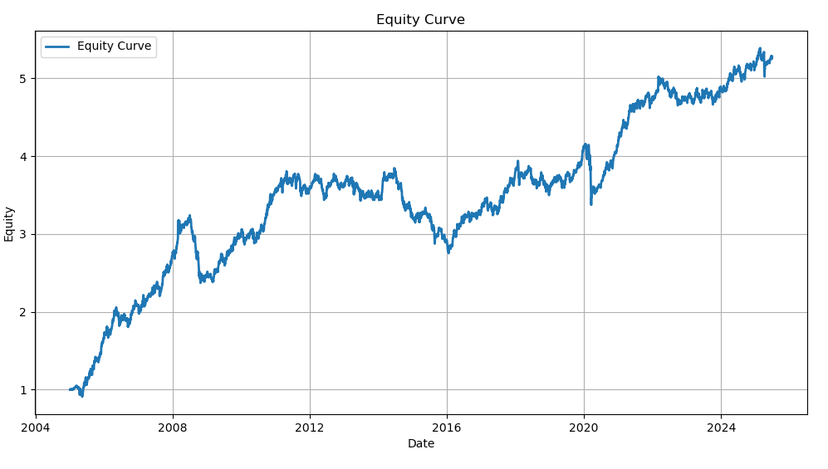

Slide 16
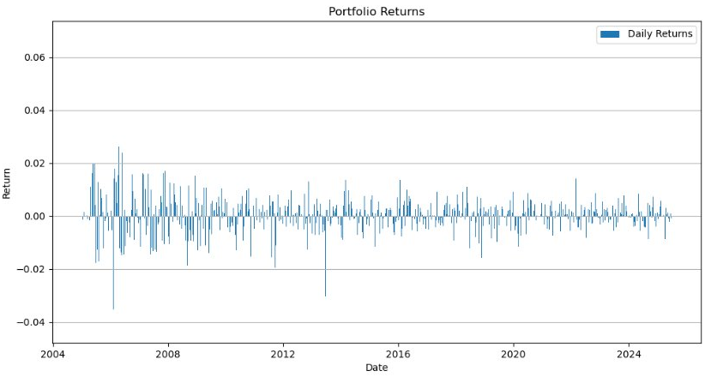

Slide 17
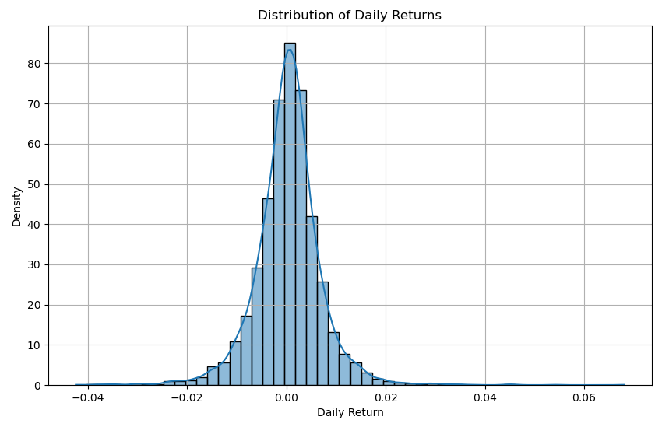

Slide 18
Return Distribution Metrics
Mean: 0.000345 (~0.0345%)
Volatility (std dev): 0.006743 (~0.67%)
Skewness: 0.2548 (slightly right-tailed)
Excess kurtosis: 7.2336 (fat-tailed distribution)
Min/Max: -0.0424 / 0.0681
VaR 95% / 99%: -0.0100 / -0.0183
CVaR 95% / 99%: -0.0154 / -0.0248
Median: 0.000479
Notes:
The mean daily return of 0.000345 indicates that the strategy earns about 0.0345% per day on average, which annualises to roughly 8.7%.
The standard deviation of 0.006743 corresponds to a daily volatility of about 0.67%, or approximately 10.7% annualised.
Skewness of 0.2548 shows a slightly heavier right tail, meaning upside outliers are somewhat more common than downside outliers.
Excess kurtosis of 7.2336 indicates that the distribution has fat tails and more extreme values than a normal distribution.
The minimum daily return was –4.24% and the maximum was +6.81%, highlighting the range of outcomes.
Value at Risk measures show that 95% of days saw losses no worse than 1%, and 99% of days saw losses no worse than 1.83%.
Conditional VaR (CVaR) averages the losses beyond those thresholds: about –1.54% in the worst 5% of days and –2.48% in the worst 1%.
The median (0.000479) is slightly higher than the mean, underscoring the distribution’s positive skew.

Slide 19
Risk, Payoff & Diagnostics
Downside volatility: 0.004852
Sortino ratio (annualised): 1.128
Tail ratio: 0.985
Hit rate: 0.5406
Avg up / down day: 0.00464 / -0.00471
Profit factor: 1.159
Jarque–Bera p-value: ≈0 (reject normality)
ACF(1): 0.0577 (weak momentum)
Notes:
Downside volatility measures the standard deviation of only negative returns; at 0.004852 it is lower than the overall volatility, indicating that down days are somewhat less volatile.
The annualised Sortino ratio of 1.128 penalises only downside risk and is higher than the Sharpe ratio, suggesting the strategy’s downside risk is well-managed relative to its average return.
The tail ratio of 0.985 compares the average size of extreme gains to extreme losses; values near 1 mean the distribution’s upper and lower tails are fairly balanced.
A hit rate of 0.5406 indicates that 54% of trading days are profitable, providing a small edge over random chance.
Average up and down days of +0.00464 and –0.00471 show that typical gains and losses are of similar magnitude.
Profit factor, at 1.159, is the ratio of total gains to total losses; values above 1 imply the strategy’s gains exceed its losses.
The Jarque–Bera test has a p-value approximately zero, meaning we strongly reject the hypothesis that returns are normally distributed, given the significant skew and kurtosis.
Autocorrelation at lag 1 of 0.0577 suggests very mild positive serial correlation (momentum) in daily returns; values near zero would indicate independence.

